Slide 1
Event Request Instructions
as an officer

Slide 2
The official campus community platform.
Tip: Keep these instructions open as you create an event.

Slide 3
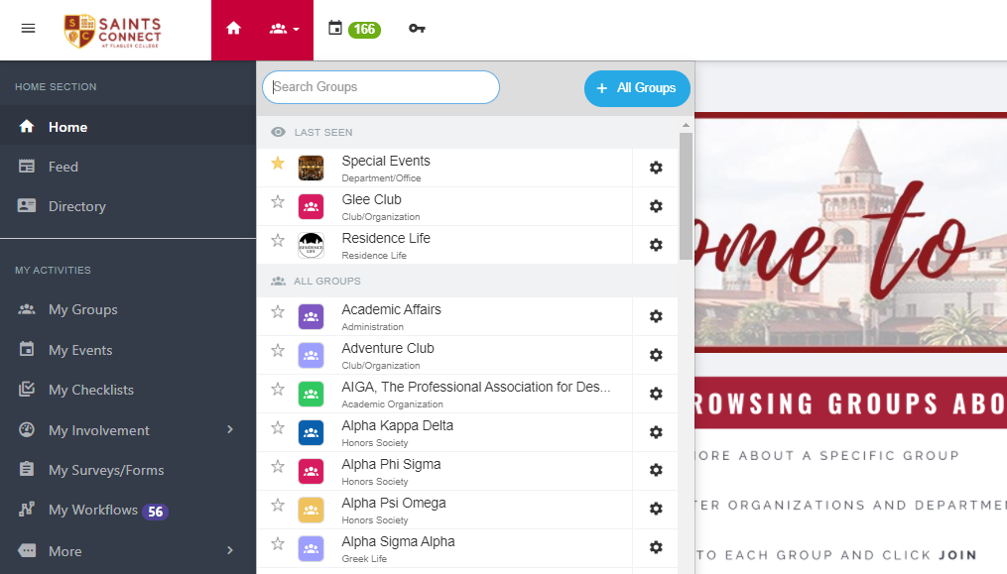
1. Toggle over the Groups option on the top bar, on the left.
1
2
2. Click on the group that you would like to submit an event for.

Slide 4
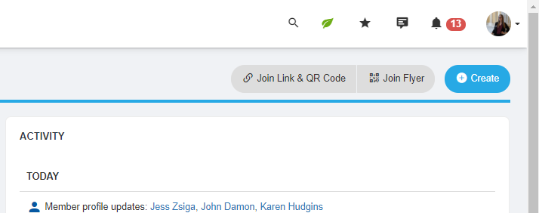
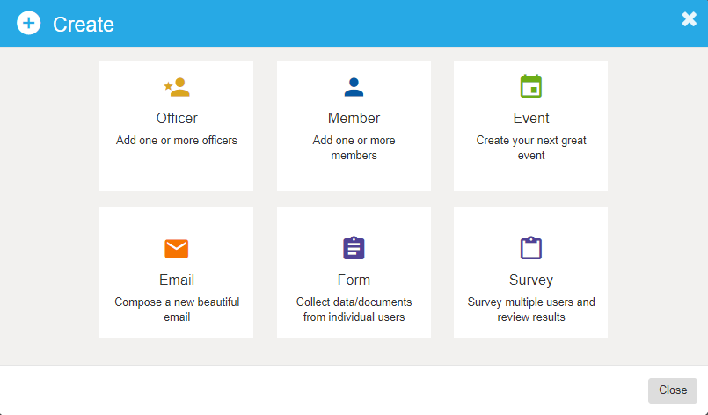
3. Click on the Create button.
3
4. Select Event.
4

Slide 5
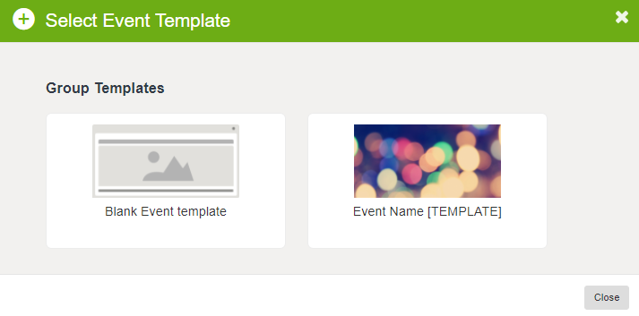
5. Select the Event Template of your choice.
If you want to create a new event template, check out our “Event Template Instructions” on the school website .
Remain patient, event templates take a few moments to load.
5

Slide 6
Populate the answers to the questions on the following page.
The only information you need to fill in or update is:
What
When
Where
Registration
Your event description will be visible based on your Access & Display Options.
Time and Date of your event (May need to adjust when using a template.)
On-Campus buildings and classrooms.
More details in registration and attendance tracking.

Slide 7
What is your event about?
You are able to select multiple event tags.

Slide 8
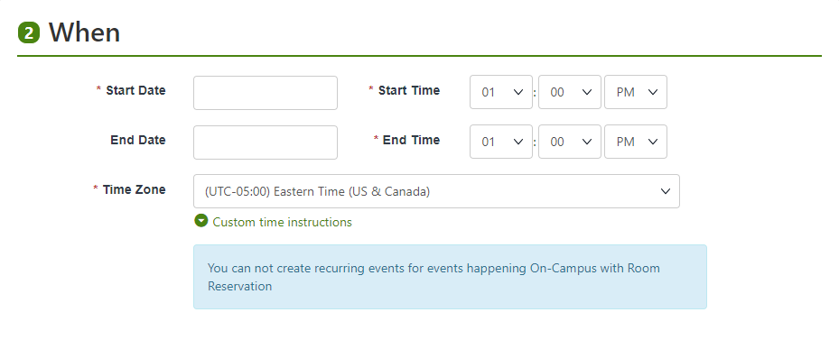
When is your event?

Slide 9
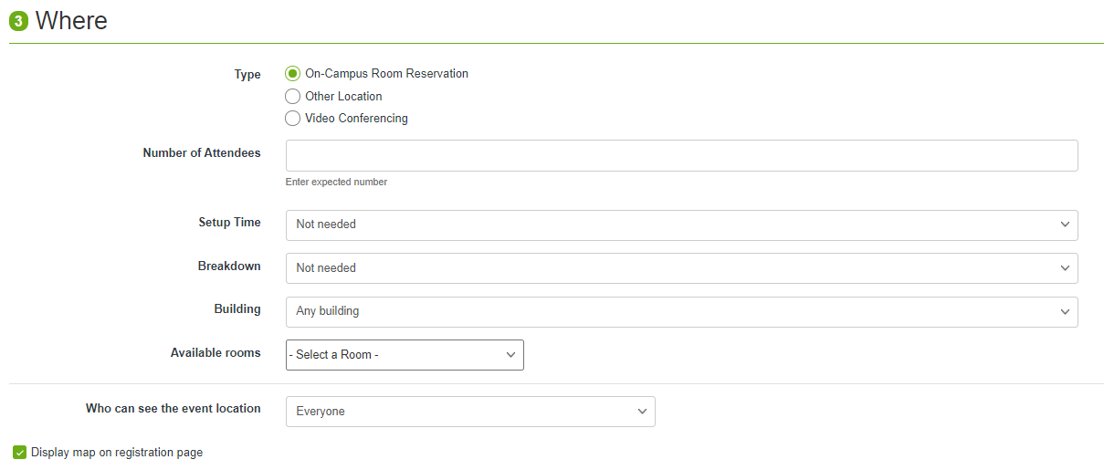
Where will your event take place?
Do not enter expected number of attendees on this page. (Will address later in the request)
May take a moment to load, be patient.

Slide 10
Online Events
For Video Conferencing Reservations

Slide 11
Online Events
For Video Conferencing Reservations
Do not include for an event template

Slide 12
Upload or Choose a Photo or Flyer
Recommend using a photo and/or flyer. This can include a group logo, special photo or a free icon provided by the platform!

Slide 13
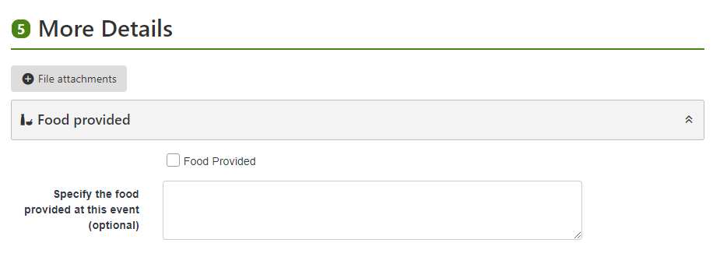
Anything Else?
If you have any additional details about your event, include them in this section. Also, if food is going to be provided, please include that information as well in your request.

Slide 14
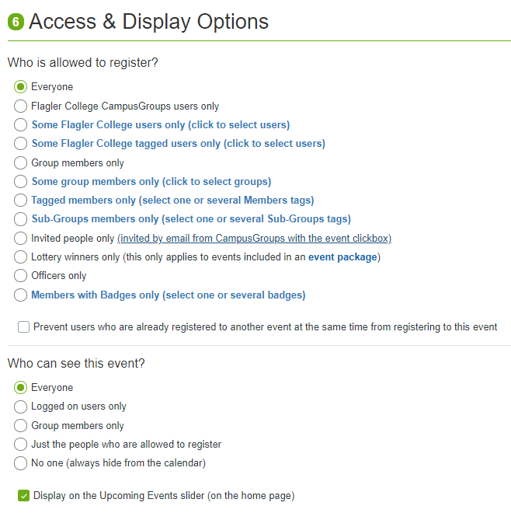
Who is this event for?
Club Meetings.
Club Leadership/Executive Board Meetings.
Recommended.
This is an easy way to advertise your event on Saints Connect.

Slide 15
Registration Details
Event Registration and Attendance is required.
Check out our tutorial on registration and attendance for more help.

Slide 16
Registration Details

Slide 17
Registration Details
Recommended.

Slide 18
Advanced Event Requests

Slide 19
Advanced Event Requests
REQUIRED FOR EVENT TEMPLATE CREATION
6. Click Create Event.
Selecting Save as Draft will not submit your event template.

Slide 20
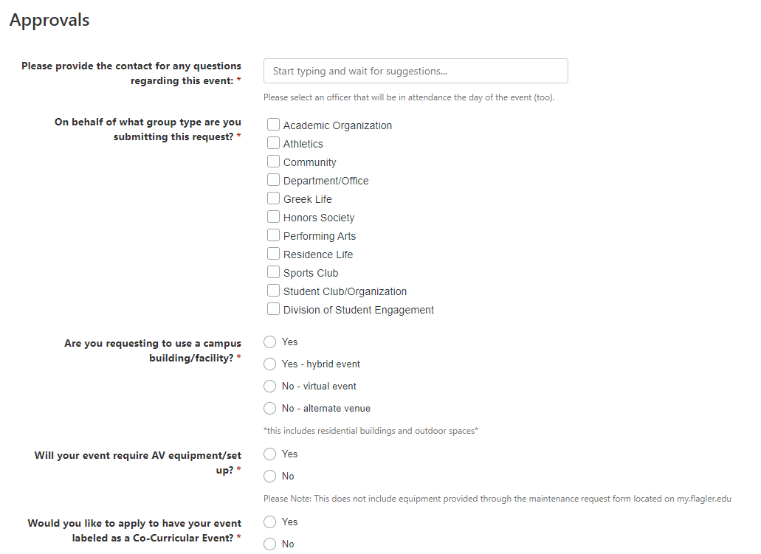
FOR EVENT TEMPLATE ONLY.
Select “no” for all questions.

Slide 21
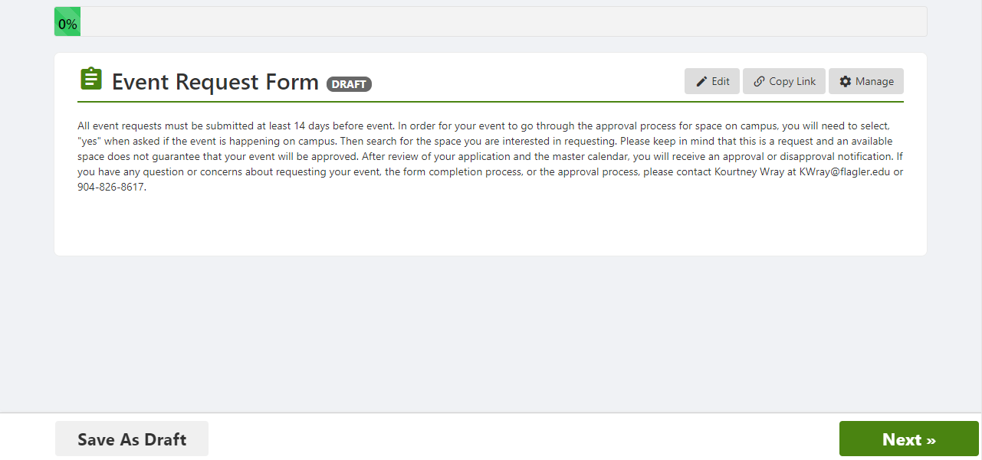
Complete the next form until progress bar is filled.
Click next, saving as a draft at any point will not allow your event to go through an approval process.

Slide 22
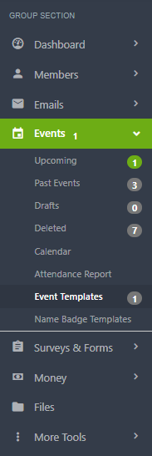
You must now wait for your Event Template to be Approved.
To review your event template, return to your group and click on Events and Event Templates.
Your event template status will be displayed next to the title.
You will be unable to use the template until the “Pending Approval” Tag is removed.

Slide 23
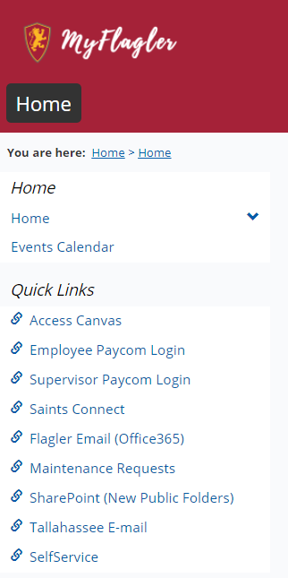
While waiting, you can submit a maintenance request!
To submit a maintenance request:
Visit the MyFlagler page and select Maintenance Requests on the left bar.

Slide 24
Additional Questions?
View our website for more tutorials
Check out the company Help Center
Please email specialevents@flagler.edu

