Slide 1
Construction Schedule Impact to Campus
Laura Stevenson Dumas
VP, Chief of Staff
April 10, 2024

Slide 2
Facilities Offline
Flagler Room (through fall 2025)
Solarium (through January 2025)
Rotunda and Dhall (May - August
Pool (May – August)
Markland Parking Lot (June/July??)

Slide 3
General Schedule
May 6 – 10
Move out Ponce West furniture
Rotunda Abatement Prep
Scaffolding in Courtyard
May 13 through August
Rotunda Abatement
Limited access to admin wing mid-June
Ponce West Abatement
Ponce West first floor “surgical” demo
May 28 – August
Chiller Underground Piping

Slide 4
Ponce Schedule

Slide 5
Underground Piping
Approx. 2 Weeks Per Run
Kenan
Ponce
Lewis
“Home Run”

Slide 6
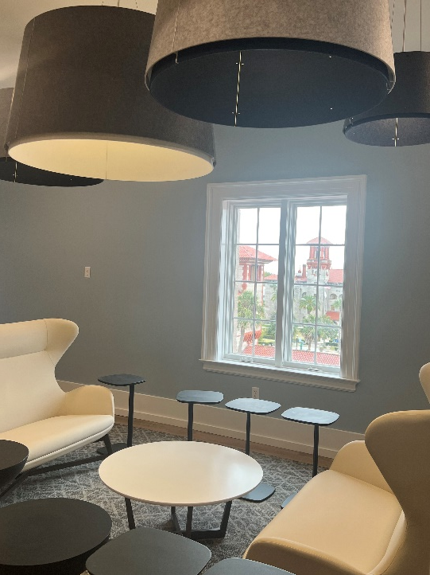
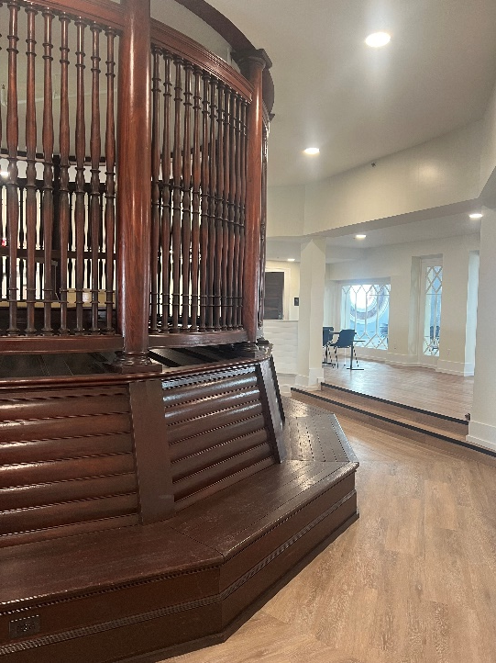
Third Floor Rotunda, “Birdcage”
Grand Opening
April 11!
10 a.m. – 11:30 a.m.

